Slide 1


Automated Image Tagging System
AWS Machine Learning Engineer Project

Slide 2


Steps
Step 1: Data Collection & Preparation
Step 2: Model Training
Step 3: Pipeline Integration
Step 4: Model Deployment

Slide 3
Step 1: Data Collection & Preparation

Slide 4
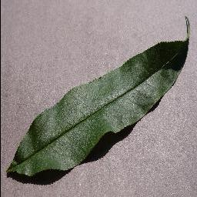
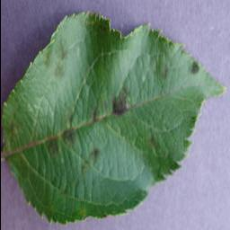
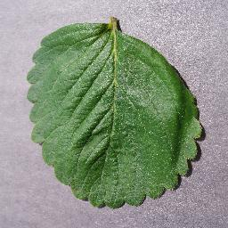
Step 1: Data Collection & Preparation
About the Dataset
This dataset consists of about 87K rgb images of healthy and diseased crop leaves which is categorized into 38 different classes. The crops in this dataset are apples, blueberries, cherries, corn, grapes, peaches, peppers, potatoes, raspberries, soybean, strawberries, and tomatoes.

Slide 5

Step 1: Data Collection & Preparation
Check for duplicates / irrelevant files
Checking for corrupt or duplicate images before training a deep learning model improves data quality, prevents training errors, speeds up convergence, and leads to more accurate and reliable model performance.

Slide 6
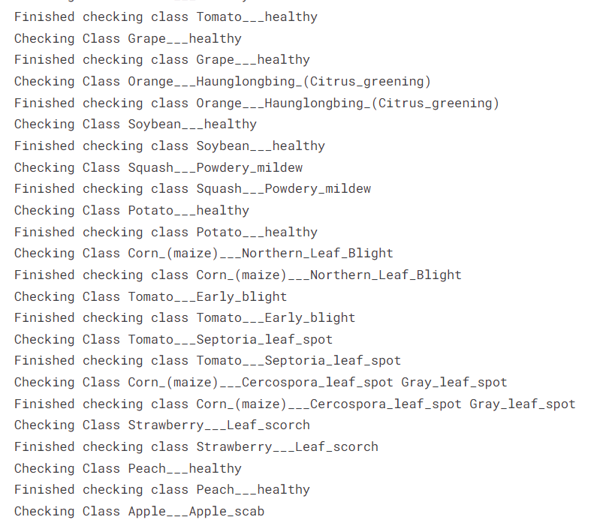
Step 1: Data Collection & Preparation
Check for duplicates / irrelevant files

Slide 7
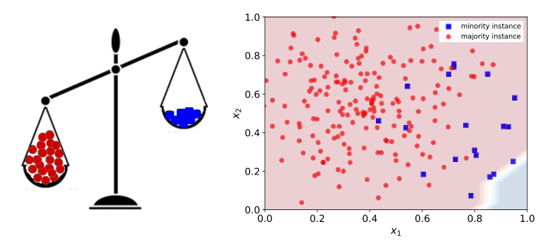
Step 1: Data Collection & Preparation
Class Imbalance Check
Detecting class imbalance early ensures that the model doesn’t overly favor the majority class, leading to fairer performance across all classes.
It also aids in selecting appropriate evaluation metrics, such as F1-score, precision, or recall, instead of relying solely on accuracy, which may be misleading in imbalanced datasets.

Slide 8
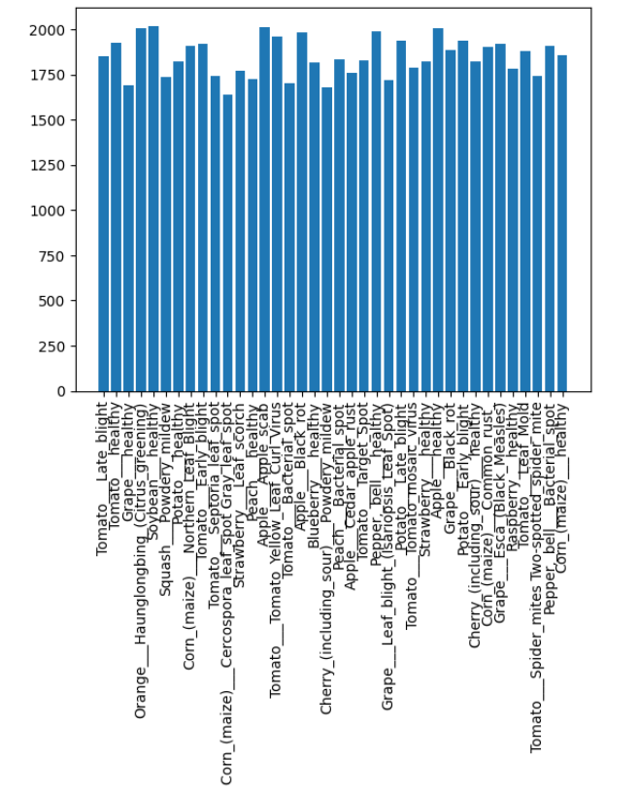
Step 1: Data Collection & Preparation
Class Imbalance Check

Slide 9
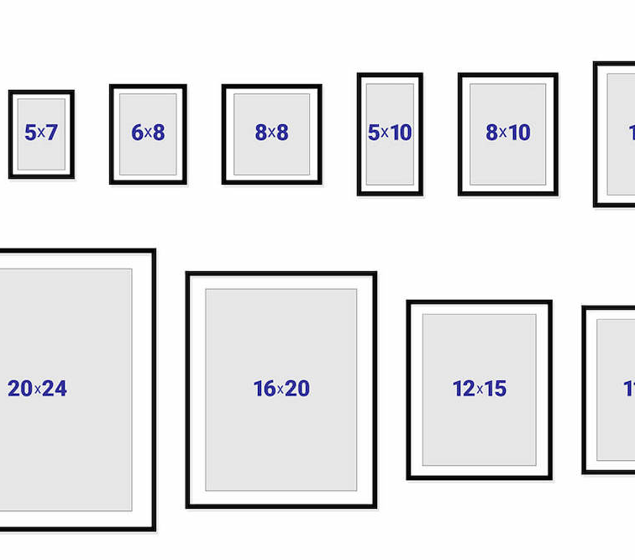
Step 1: Data Collection & Preparation
Specify Image Size & No. of Batches
Defining image size ensures uniformity, allowing the model to learn more effectively from the data without resizing inconsistencies.
Choosing an optimal batch size improves convergence and stability during training, helping to prevent overfitting or underfitting.

Slide 10
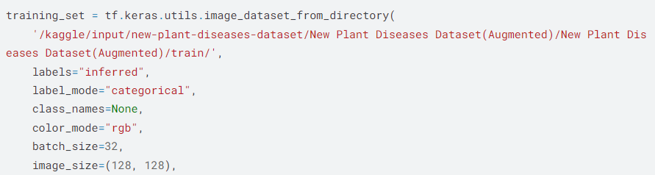
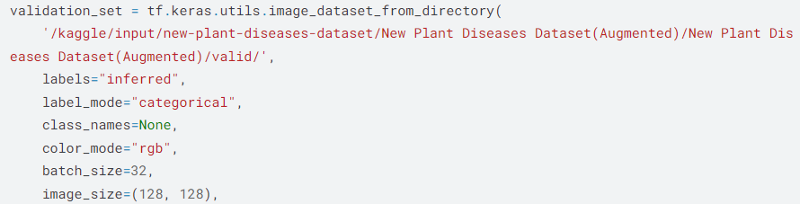
Step 1: Data Collection & Preparation
Specify Image Size & No. of Batches

Slide 11
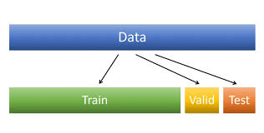
Step 1: Data Collection & Preparation
Training & Validation Split
Splitting data into training and validation sets allows for unbiased evaluation of the model during training.
It helps monitor performance on unseen data, detect overfitting early, and tune hyperparameters effectively.
By using validation data, you can test the model's generalization ability.

Slide 12
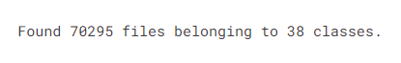
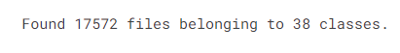
Step 1: Data Collection & Preparation
Training & Validation Split

Slide 13
Step 2: Model Training

Slide 14
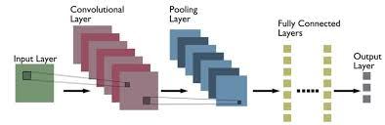
Step 2: Model Training
CNN Layers
Convolutional Layer: Extracts features from input data by applying filters to detect patterns like edges and shapes in images.
Pooling Layer: Reduces spatial dimensions, retaining essential features while lowering computational load.
Dropout Layer: Randomly disables a fraction of neurons during training to prevent overfitting.

Slide 15
Step 2: Model Training
CNN Layers

Slide 16

Step 2: Model Training
Activation Functions
An activation function introduces non-linearity to a neural network, enabling it to learn complex patterns. It determines the output of each neuron and helps the model handle diverse data representations effectively. Common examples include ReLU, Sigmoid, and Tanh.

Slide 17
Step 2: Model Training
Activation Functions

Slide 18
Step 2: Model Training
Optimizers & Loss Function
Optimizers are algorithms used to adjust model weights to minimize the loss during training. They determine how the model learns by controlling the step size (learning rate) and direction of updates to reduce errors. Common optimizers include SGD, Adam, and RMSprop.
Loss functions measure the difference between the model's predictions and the actual target values. They guide the optimizer by indicating how far off the predictions are. Common loss functions include Mean Squared Error (MSE) for regression tasks and Cross-Entropy for classification tasks.

Slide 19
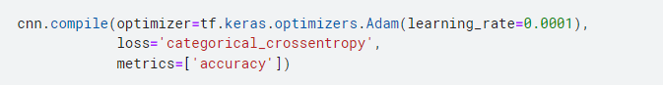
Step 2: Model Training
Optimizers & Loss Function
The learning rate is a crucial hyperparameter in deep learning that controls the size of the weight updates during training. It determines how quickly or slowly a model learns. If the learning rate is too high, the model may overshoot the optimal solution, leading to instability or poor convergence. If it's too low, training can become very slow, and the model might get stuck in local minima.

Slide 20
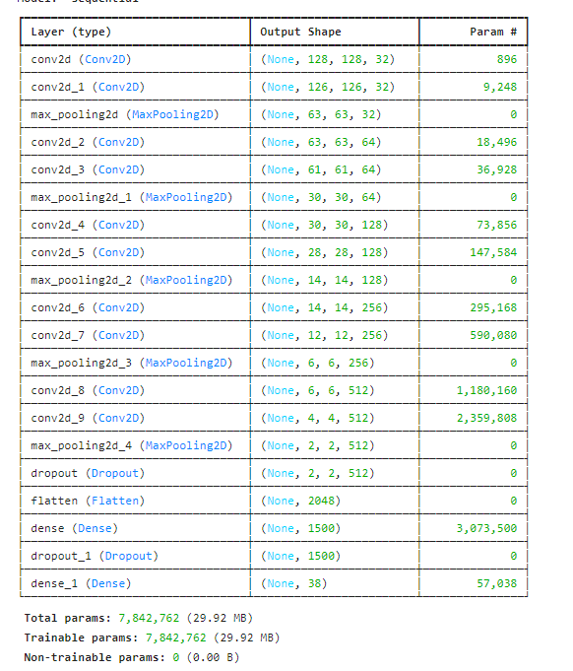
Number of Parameters

Slide 21
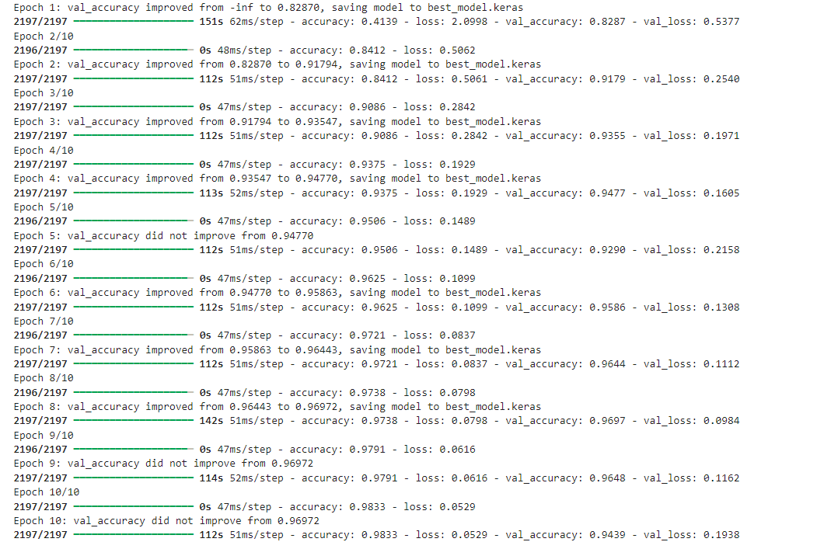

Slide 22
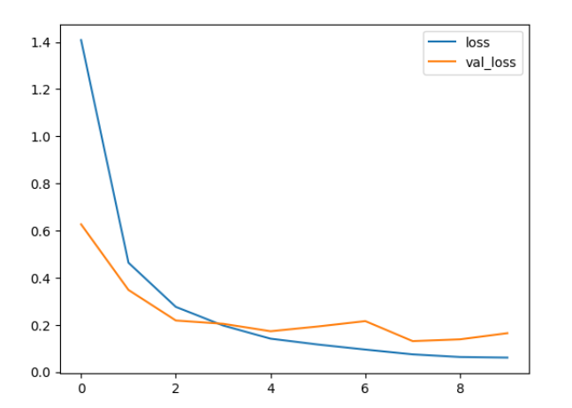
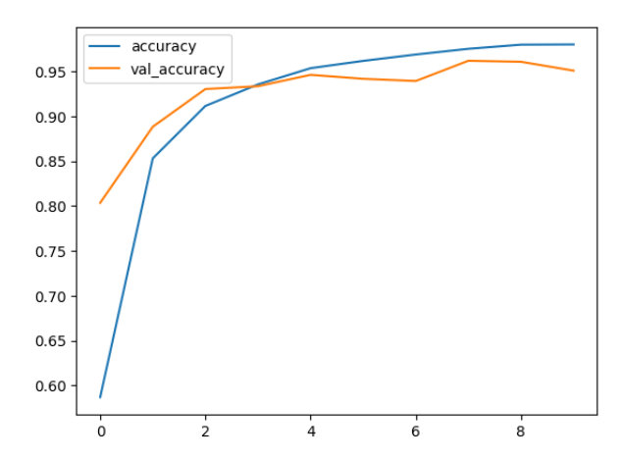
Step 2: Model Training
Training & Validation Loss and Accuracy

Slide 23
Step 3: Pipeline Integration using ML-Flow

Slide 24
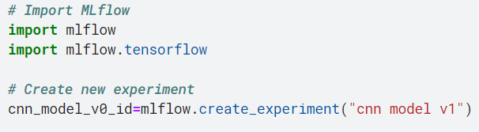
Step 3: Pipeline Integration Using Mlflow
Creating an experiment
Importing mlflow library and the TensorFlow flavor
Storing the experiment ID cnn_model_v0_id

Slide 25
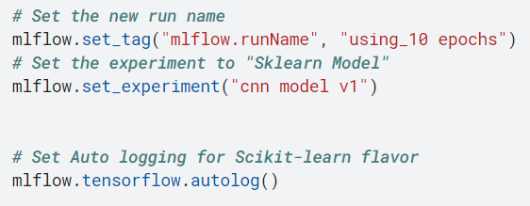
Step 3: Pipeline Integration Using Mlflow
Experiment Configuration
Assign a runName tag and setting the experiment
Enable Auto Logging for TensorFlow
Activate auto logging for TensorFlow, which allows mlflow to automatically log parameters, metrics, and model checkpoints during training.
start the MLflow UI server
allowing you to interact with your logged experiments through a web interface. MLflow UI runs on port 5000 by default.

Slide 26
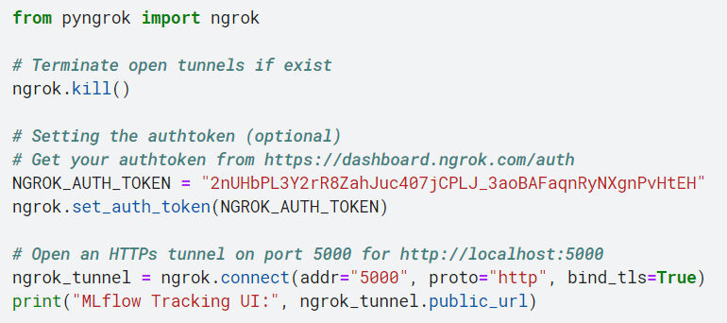
Step 3: Pipeline Integration Using Mlflow
MLflow Tracking UI via ngrok
Enable secure remote access to a locally hosted MLflow Tracking UI by creating a public, HTTPS-accessible URL.
Returns a dynamic URL valid for 8 hours

Slide 27
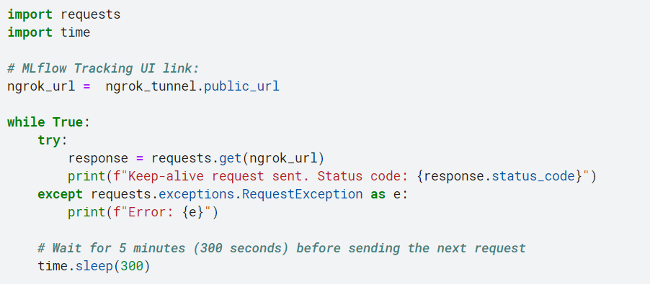
Step 3: Pipeline Integration Using Mlflow
Maintaining ngrok Tunnel Activity with Keep-Alive Requests
To Prevent the ngrok tunnel from timing out or closing due to inactivity by sending periodic keep-alive HTTP requests to the MLflow Tracking UI..

Slide 28
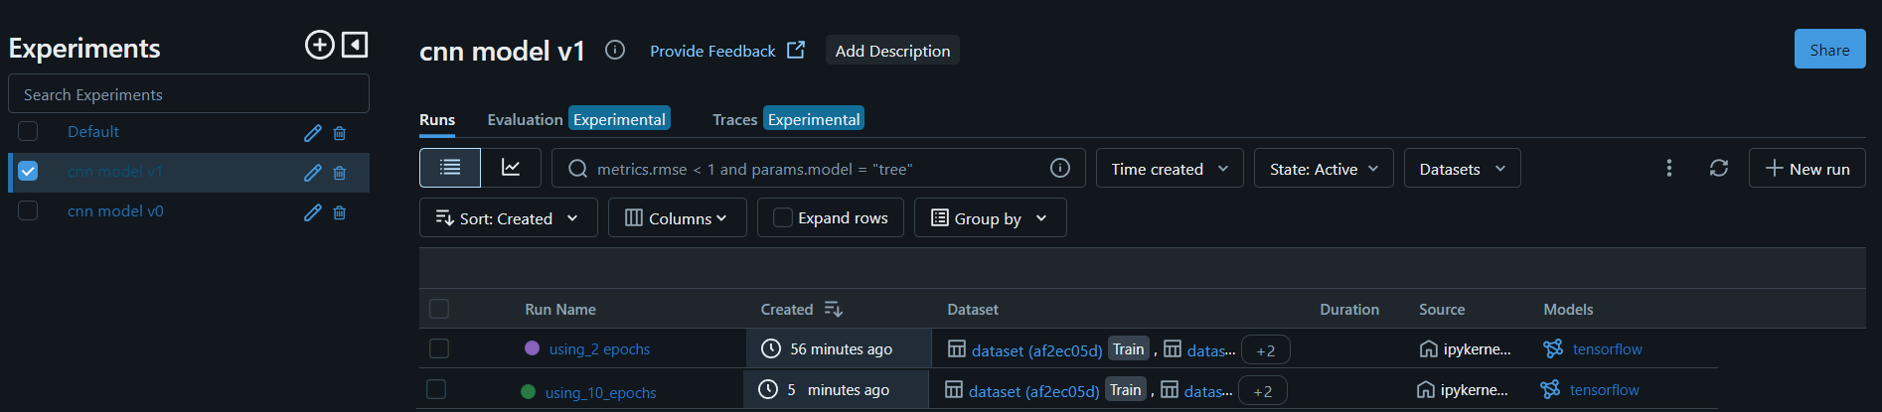
Step 3: Pipeline Integration Using Mlflow
MLflow Tracking UI

Slide 29
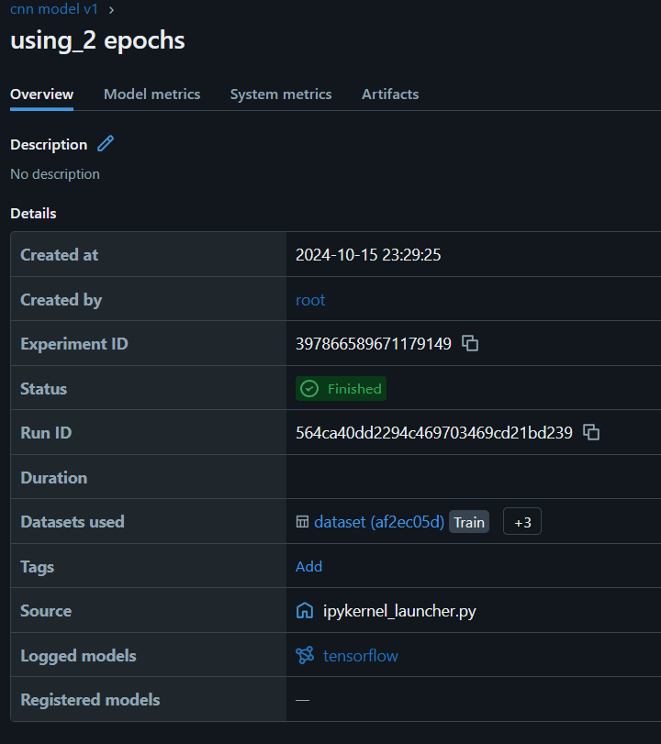
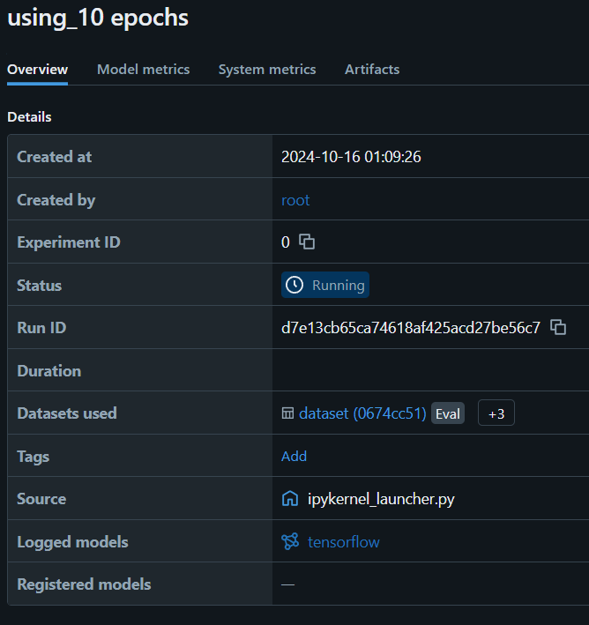
Step 3: Pipeline Integration Using Mlflow
MLflow Tracking UI

Slide 30
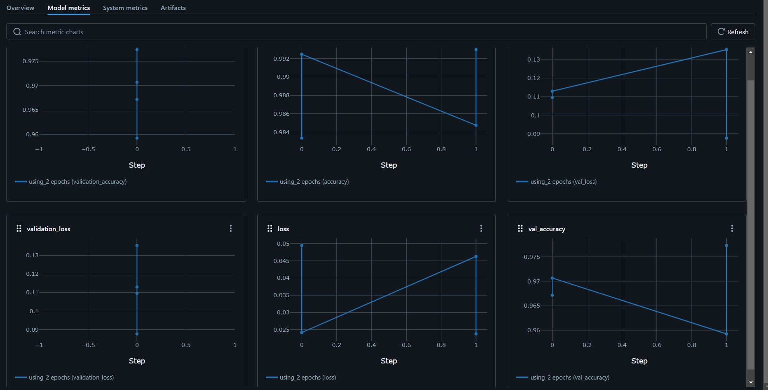
Step 3: Pipeline Integration Using Mlflow
Using_2 epochs

Slide 31
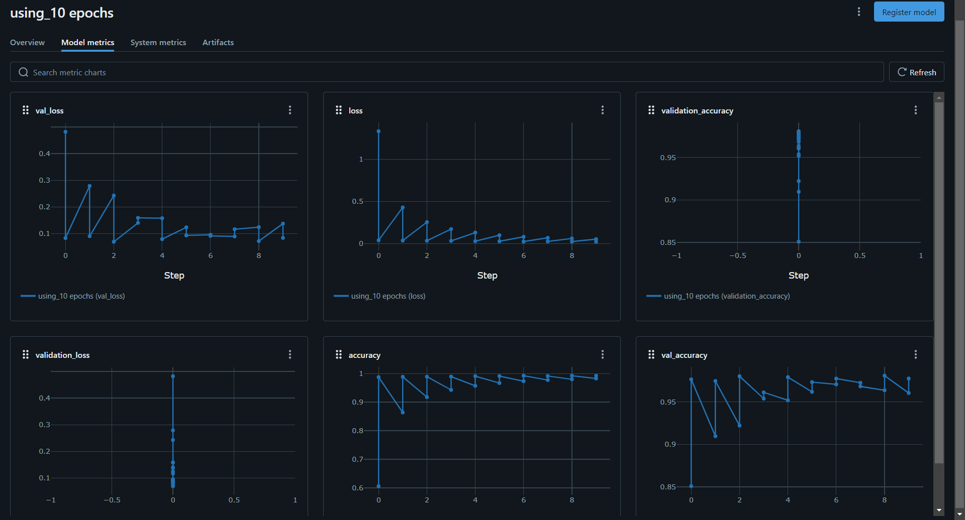
Step 3: Pipeline Integration Using Mlflow
MLflow Tracking UI

Slide 32
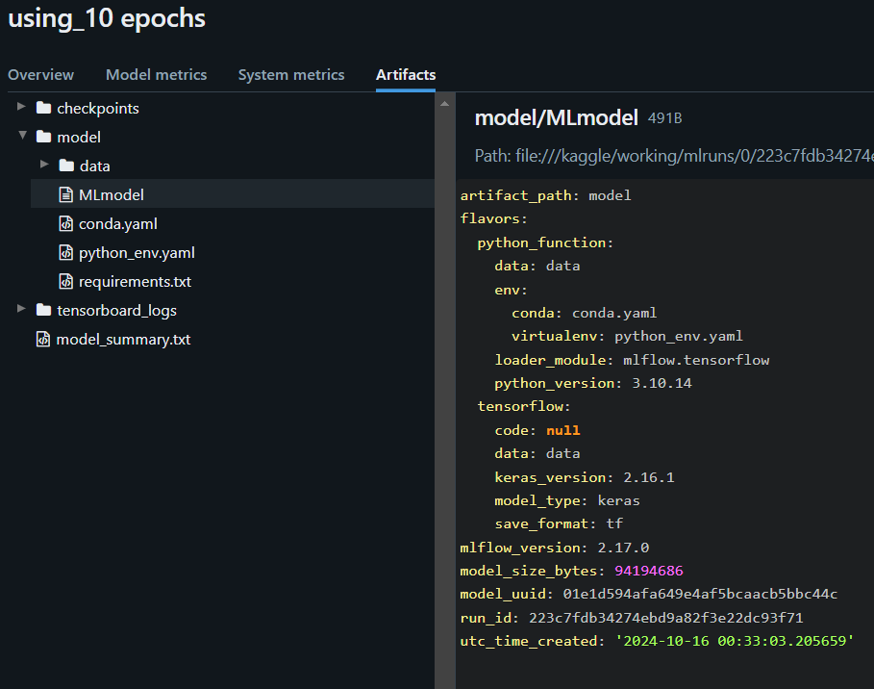
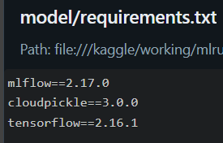
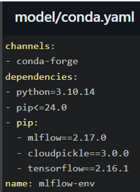
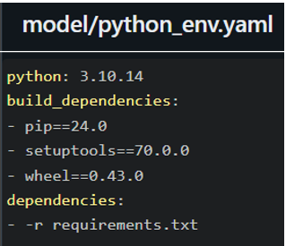
Step 3: Pipeline Integration Using Mlflow

Slide 33
Step 4: Model Deployment

Slide 34

Step 4: Model Deployment
Model Deployment Strategy
The model was deployed using a Flask web application. Flask provides a simple and lightweight interface where users can upload plant images. The backend loads the pre-trained model and performs the prediction, returning the detected disease to the user.

Slide 35
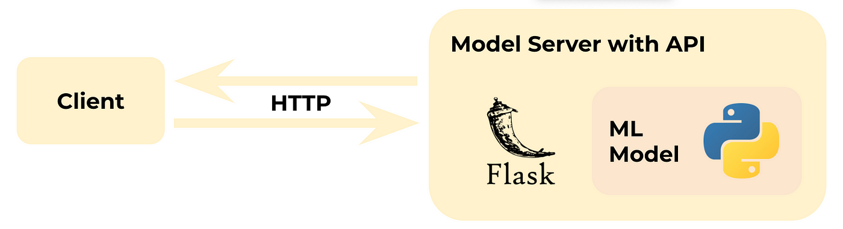
Step 4: Model Deployment

Slide 36

Step 4: Model Deployment
AgriScan web app

Slide 37
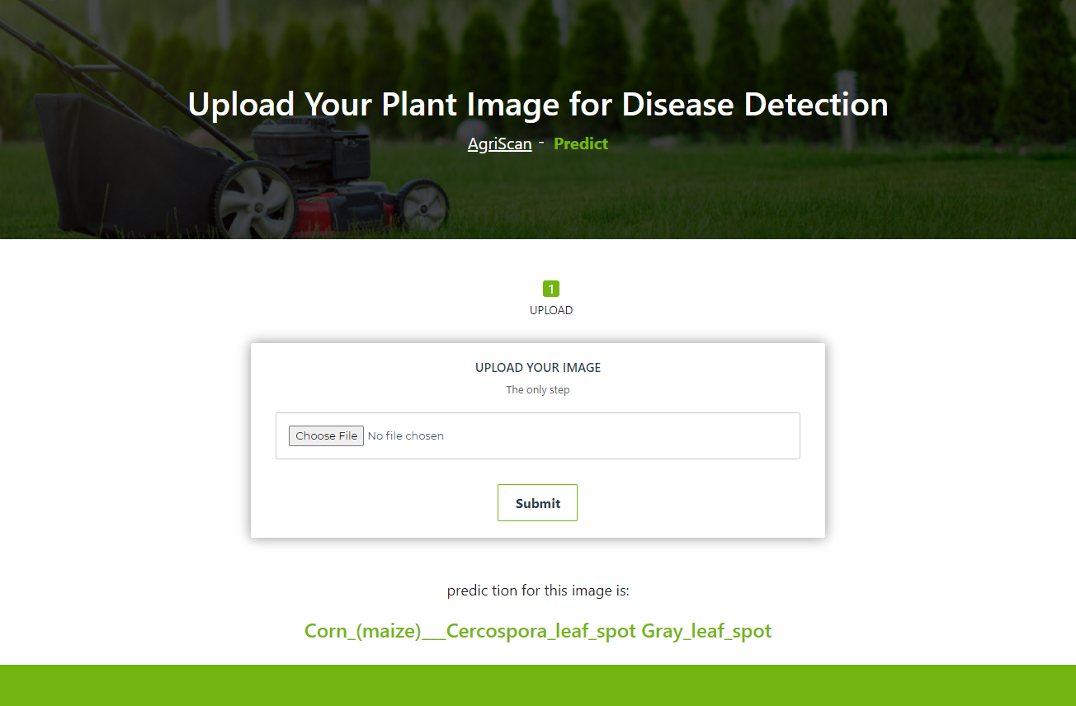
Step 4: Model Deployment

Slide 38

Thank you!

